Slide 1

C OM P U T E R N E T W O R K S

Slide 2
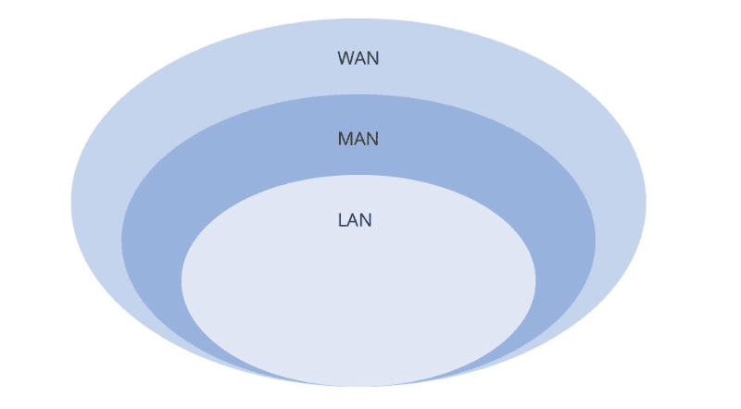
LAN, WANS AND OTHERS
Their characteristics and other type of Network commonly used.

Slide 3
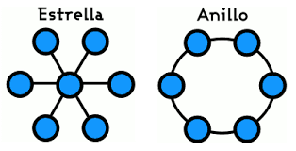
NETWORK TOPOLOGIES
What is a network topology?
And explain various network topologies

Slide 4
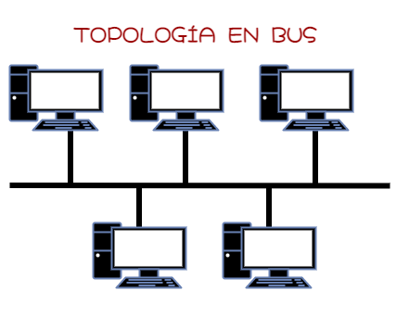
Bus Topology
Are connected to a channel.

Slide 5
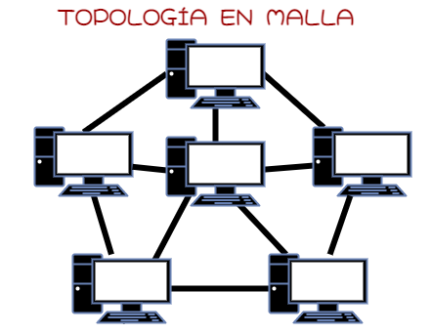
Mesh Topology
All devices are interconnected
It’s to expensive to install

Slide 6
SETTING UP A NETWORK HOME NETWORK

